Slide 1


SONG LYRICS ANALYSIS
SONG LYRICS ANALYSIS
Based on the
Billboard Year-End
Hot 100 Singles Chart
by Jay Park
Notes:
Hello everyone! My name is Jay Park and I’m excited to present my work on the topic of song lyrics analysis

Slide 2

TABLE OF CONTENTS
01
03
02
04
INTRODUCTION
CLUSTERING
EVALUATING
TOPICS
CONCLUSIONS
Notes:
Today, I will first introduce you to the project, and then talk about the extracted topics in depth
Then I will do further analysis with clustering, before I finally move into conclusions

Slide 3

RESEARCH QUESTION
Analyze popular U.S. song lyrics from the 90s to 2010s
Analyze popular U.S. song lyrics from the 90s to 2010s
Notes:
So my research question is,
Analyzing popular song lyrics from the 90s to the 2010s.
And using unsupervised learning techniques, I sought to extract meaningful information from the dataset

Slide 4






DATA ACQUISITION & TOPIC MODELING
♫ Used Year-End Charts
♪ Scraped 3000 song lyrics (30 years)
♩ 2671 songs after cleaning
♮ TF-IDF and NMF for topic modeling
Notes:
In choosing the songs I want to analyze, I utilized the Billboard Year-End Charts
At the end of each year, Billboard releases a list of the 100 most popular songs for that year.
------------------------Radio Airplay + Sales + (starting more recently) Streaming statistics
I scraped 3000 song lyrics using BS and a Genius API, and after processing I was left with 2671 songs
On that dataset I performed TF-IDF followed by NMF for topic modeling. And I was able to extract 5 relevant topics, which I will go over one by one.

Slide 5
TOPICS
TOPIC 1: “Dreams”
WORDS
CHARACTERISTICS
EXAMPLES
believe, dream, stay, friend, gone, try, forever, better, true, long, home, wrong
Often heartwarming, optimistic, and wishful. Emotive expressions abound.
We Belong Together
(Mariah Carey)
Some Nights
(fun.)
This I Promise You
(‘N Sync)
Notes:
The first exctracted topic was one I ended up calling “dreams”
Relevant words in this topic includes….
Songs with high scores in this topic tend to be
Some examples of songs with high scores

Slide 6
TOPICS
TOPIC 2: “Expletives/Gansta”
WORDS
CHARACTERISTICS
EXAMPLES
ni***, bi***, sh**, fu**, ayy, money, gon, real, bad, lil, h**, big, hit
Lots of expletives, much talk about being young, hot, and rich.
Gummo
(6ix9ine)
Cash Sh**
(Megan Thee Stallion ft. DaBaby)
I Don’t Fu** with You
(Big Sean ft. E-40)
Notes:
The second extracted topic is this …. Expletives/Gangster topic
The important defining words include the n-word
As you see, these songs tend to have…. and talk a lot about

Slide 7
TOPICS
TOPIC 3: “Passion/Love”
WORDS
CHARACTERISTICS
EXAMPLES
tonight, alright, waiting, tomorrow, fight, party, kiss, drink, tight, inside, dancing, touch
Suggestive language and talks of clubbing, drinking, and staying up all night.
Give Me Everything
(Pitbull ft. Ne-Yo, Afrojack, Nayer)
Teenage Dream
(Katy Perry)
Animal
(Neon Trees)
Notes:
I named the third topic Passion slash Love.
Important words include
These songs have
Examples are this Pitbull song…

Slide 8
TOPICS
TOPIC 4: “Dance”
WORDS
CHARACTERISTICS
EXAMPLES
dance, body, shake, rock, everybody, party, stop, turn, floor, play, music, round
Dance, dance, dance. And dance some more.
Can’t Stop the Feeling!
(Justin Timberlake)
Party Rock Anthem
(LMFAO)
Just Lose It
(Eminem)
Notes:
Fourth, the topic is called “Dance”
You have words like….
(skip characteristics)
Examples include

Slide 9
TOPICS
TOPIC 5: “Reminisce”
WORDS
CHARACTERISTICS
EXAMPLES
remember, used, memory, forget, gave, bring, fell, saying, wish, hurt, walk, bye
Singer makes you wonder if you have amnesia.
Do You Remember
(Phil Collins)
I’ll Remember
(Madonna)
Someone Like You
(Adele)
Notes:
The final topic is an interesting one, one I named “reminisce”
Important words include
And these songs are related to memory. A lot of these songs keep asking you, do you remember this, remember that.

Slide 10
KMEANS CLUSTERING & PCA
‘DREAMS’
‘REMINISCE’
‘EXPLETIVES/GANGSTA’
‘PASSION/LOVE’
‘DANCE’
K-MEANS CLUSTERING
PRINCIPAL COMPONENT ANALYSIS
Notes:
Cool, now we have five topics that we extracted.
Using the topic-document matrix that was generated from the NMF, I proceeded to do K-Means Clustering to generate 15 clusters, and then did PCA for visualization

Slide 11
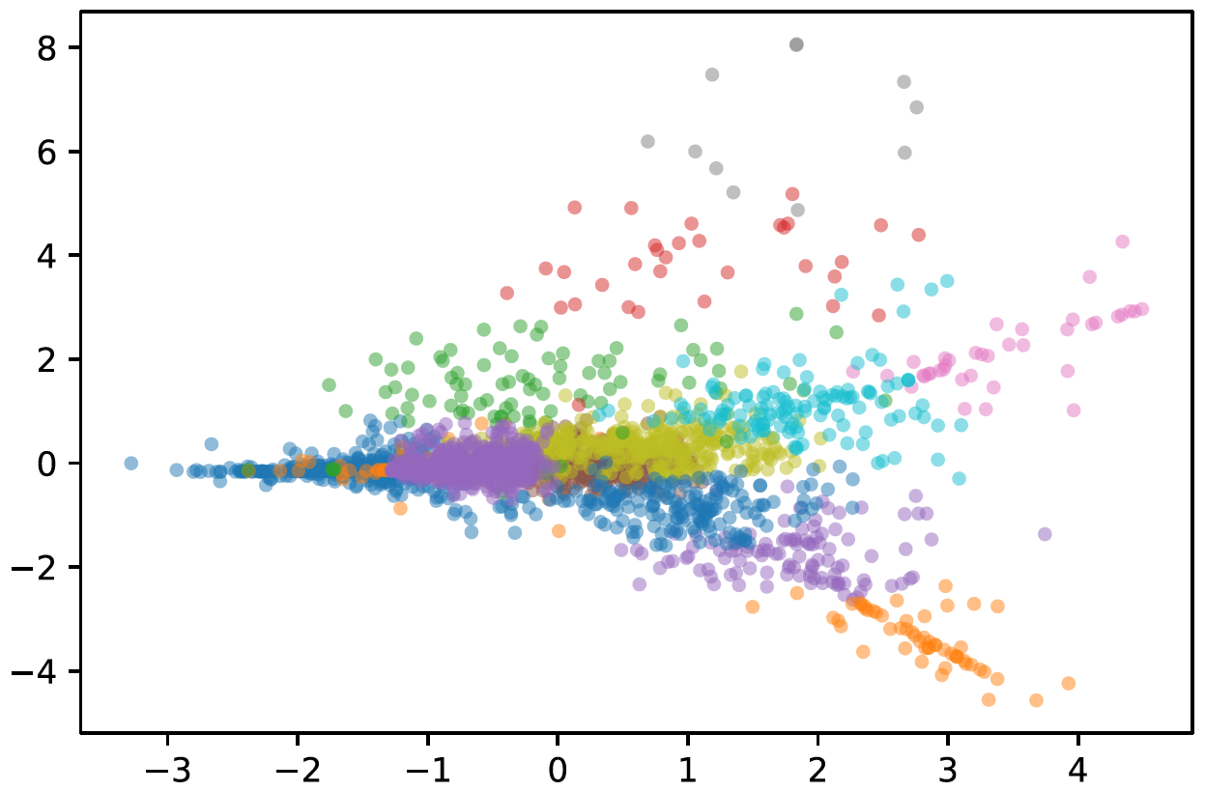
KMEANS CLUSTERING & PCA
Notes:
So here’s the resulting plot

Slide 12
KMEANS CLUSTERING & PCA
Cluster 10
Cluster 11
Notes:
To give you a better sense of the what this represents, I’d like you to compare these two clusters.
Just based on the plot we can predict that Cluster 11 has a very distinctive style compared to Cluster 10, which should be more mainstream

Slide 13
KMEANS CLUSTERING & PCA
Cluster 11
Cluster 10
Cluster 11
I Don’t Fu** With You
(Big Sean ft. E-40)
Bi*** Better Have My Money
(Rihanna)
The Motto
(Drake)
Notes:
And that’s exactly what we see
Cluster 11 had songs that scored very highly on the “Expletive/Hip-hop” topic, including songs such as ….

Slide 14
KMEANS CLUSTERING & PCA
Cluster 10
Hollaback Girl
(Gwen Stefani)
Paper Planes
(M.I.A.)
Empire State of Mind
(Jay-Z ft. Alicia Keys)
Cluster 11
Cluster 10
Cluster 11
I Don’t Fu** With You
(Big Sean ft. E-40)
Bi*** Better Have My Money
(Rihanna)
The Motto
(Drake)
Notes:
In contrast, cluster 10 had more “mainstream” songs, like these.
But still, a good majority of the songs in cluster 10 had some influences from the genre represented by cluster 11
This all made intuitive sense and validates the PCA and the clustering.

Slide 15
KMEANS CLUSTERING & PCA
“Passion”
“Dance”
“Dreams”
“Expletives”
Notes:
Doing similar analyses for the other clusters, I saw that the topics have “home grounds” on the corners of the PCA plot, so to speak.

Slide 16
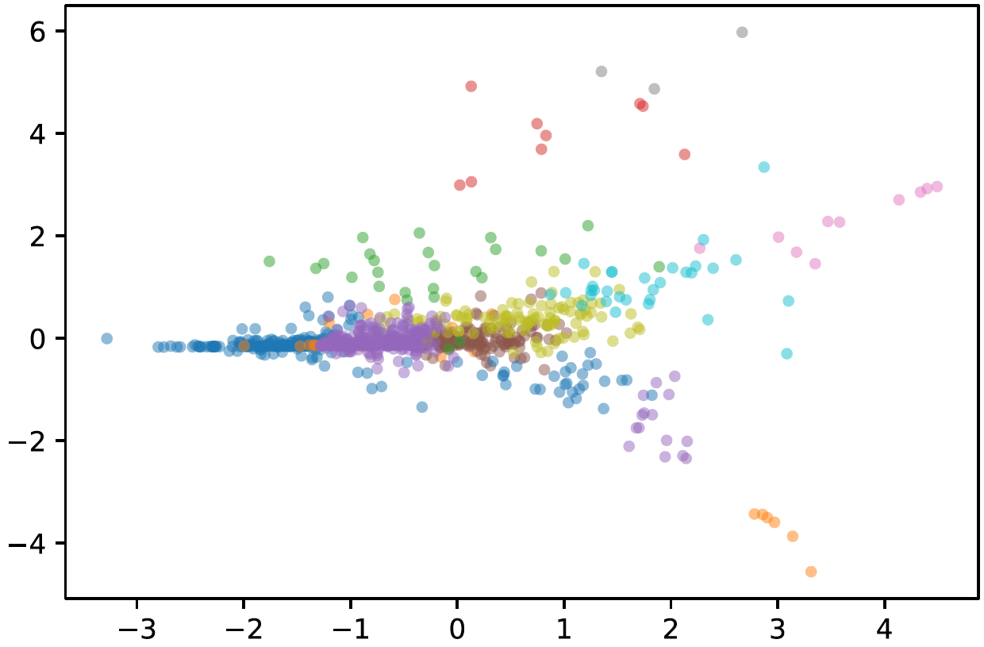
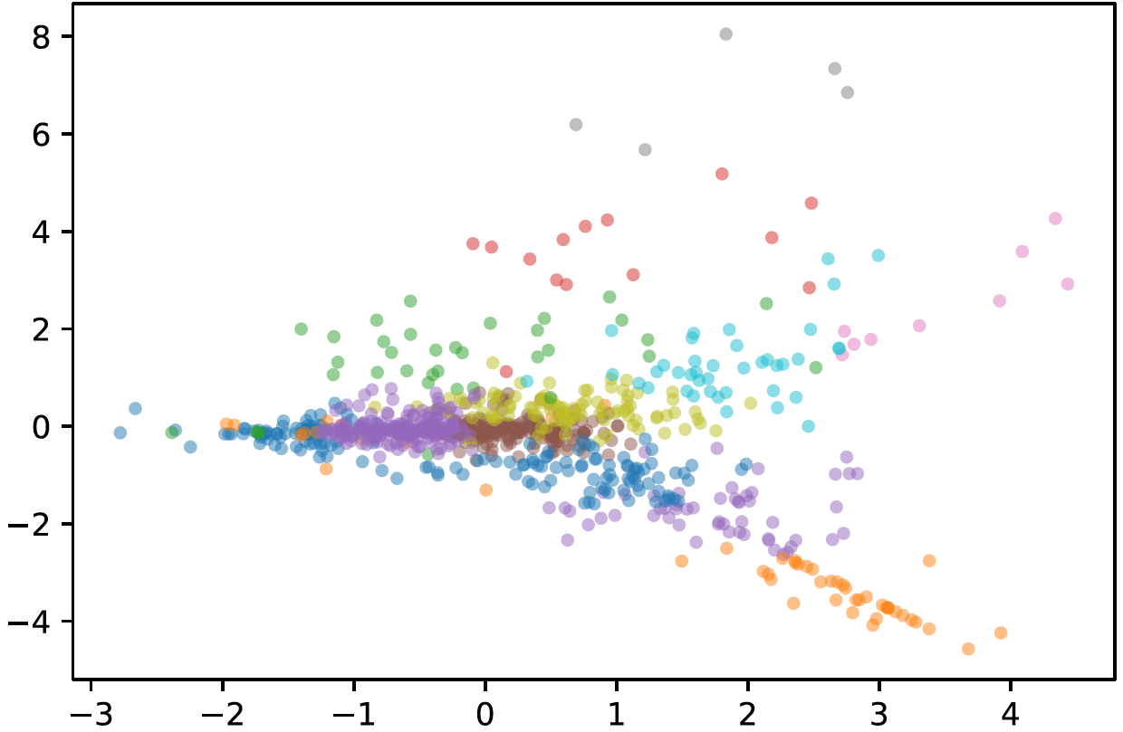
KMEANS CLUSTERING & PCA
1990s
2010s
Notes:
In addition, when you compare songs just from the 90s and just from the 2010s

Slide 17
KMEANS CLUSTERING & PCA
1990s
2010s
600%
Cluster 11
Cluster 3
72%
Notes:
I saw two clusters that had very big changes in their proportions over time

Slide 18
KMEANS CLUSTERING & PCA
1990s
2010s
600%
Cluster 11
(songs heavy on the ‘Expletives/Gangsta’ topic)
Cluster 3
72%
(songs heavy on the ‘Reminisce’ topic)
Notes:
And it turns out songs heavy on the hip-hop topic saw a huge boost in numbers over the years
While the reminisce topic saw a big decline,
Which was interesting.

Slide 19

CONCLUSIONS & FUTURE DIRECTIONS
Notes:
So in conclusion,

Slide 20

CONCLUSIONS & FUTURE DIRECTIONS
Five major topics extracted from 1990-2019 US song lyrics
Extend study into other decades (in the US)
Composition of topics have changed
Extend study into other countries’ music markets
Notes:
For popular songs in the last 30 years, 5 major themes can be extracted from their lyrics.
Compositions of the topics have changed over the years.
In the future, I plan to extend this study into other decades, as well as other countries.

Slide 21
THANKS
THANKS
Does anyone have any questions?

Slide 22
CREDITS
This is where you give credit to the ones who are part of this project.
Presentation template by Slidesgo
Icons by Flaticon
Infographics and images by Freepik
Author introduction slide photo created by Freepik
Text & Image slide photo created by Freepik.com

